Slide 1
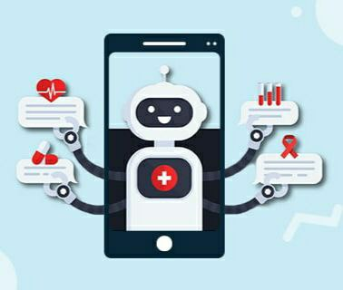
Ai based Chat bot for providing health related information
TEAM MEMBERS
AKULA KARTHIKEYA(2010030442)
MUNJALA GANESH(2010030420)
Guide:
Dr. Ramarao

Slide 2
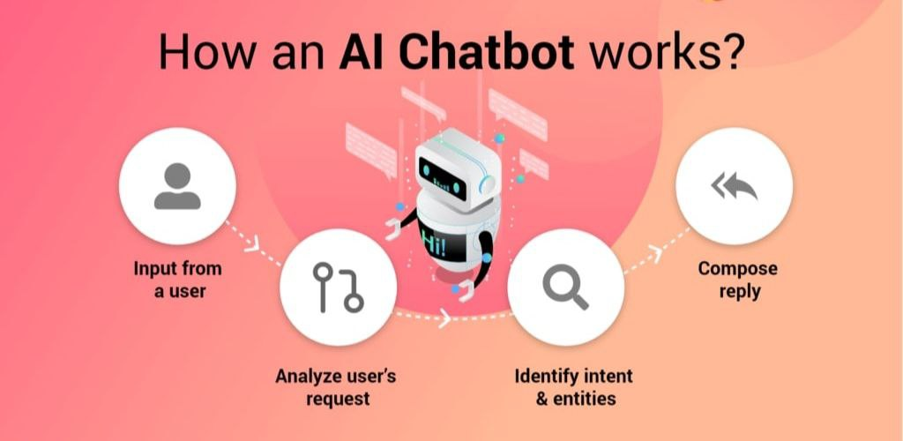
INTODUCTION
In the medical requirements, AI-based chatbots are utilized for treating patients and advice them in getting relevant guiding.
Chatbots in health related fields provides patient assistance and care.
The chatbot is also known as chat robots,
are software agents that simulate human
conversation via text or voice messages
through internet.
The main influence that the
people to use chatbots:
Fun
social and relational influence
productivity
Curiosity
Explainability

Slide 3
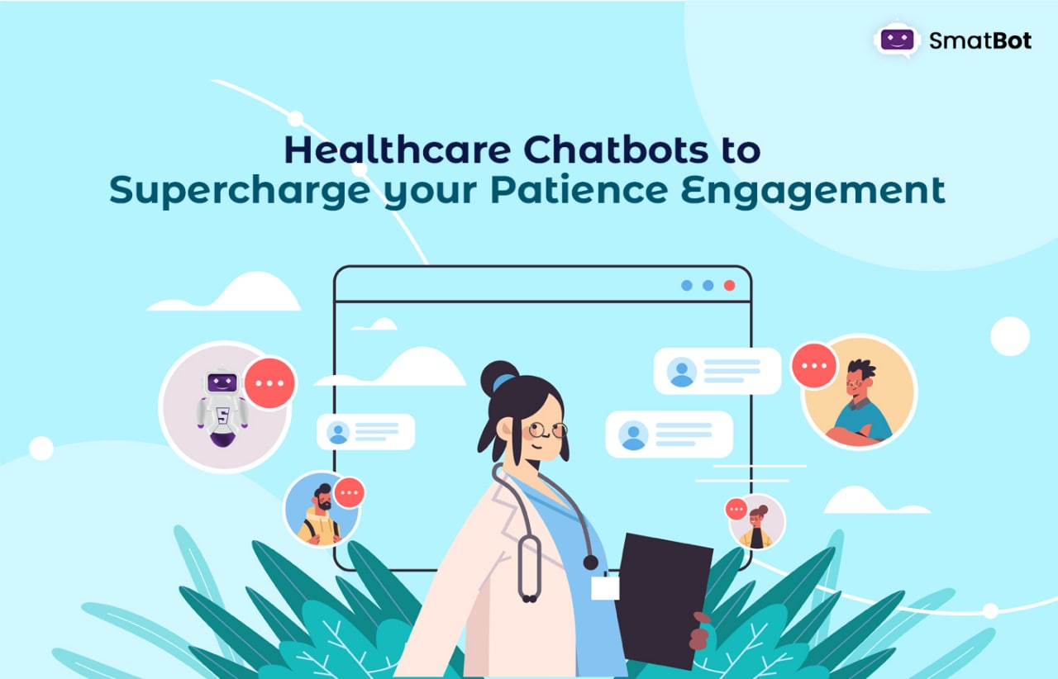
ABSTRACT
To live a good life health is very important. But it is very difficult to the consult the doctor if any health issues. The proposed idea is to create a health related chatbots using Artificial Intelligence that can diagnose the disease and provide basic to reduce the healthcare costs and improve accessibility to medical knowledge .
The user can achieve the benefit of a healthcare chatbot only when it can diagnose all kind of disease and provide necessary information.
The system provides text or voice assistance, Bot will provides which type of disease based on the user symptoms, and provides doctor advice and also provides food suggestion that means which type of food you have to take and images related to disease. Thus, people will have an idea about their health and have the right protection...

Slide 4
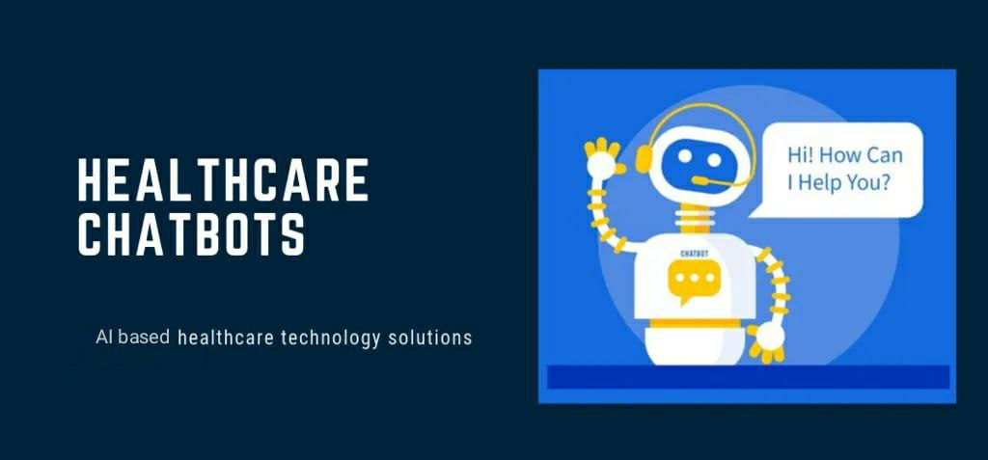
Problem statement
For some people it is difficult to consult the doctor, some people don‘t go to hospital for even any small problem and some people cannot pay hospital requirement.
Chat bots in health care may have the potential to provide patients with access to immediate medical information. Health care chat bots could help patients better manage their own health, improve access and timeliness to care.
So for these people our chatbot acts as a medical reference, which helps the patient know more about their disease and helps to improve their health.

Slide 5
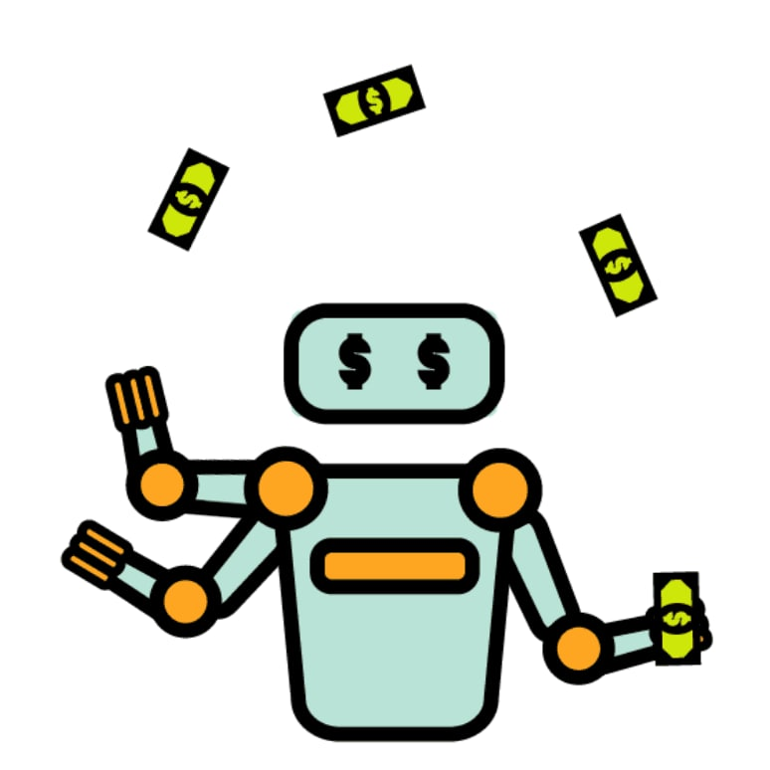
Existing problem
Many of the existing systems have live chats through texts and some limitation such as there is no instant response given to the patients they have to wait a long time. Some of the processes may charge amount to live chat communication.
It takes more time to response to the user question
Pay some charges to perform live chat

Slide 6
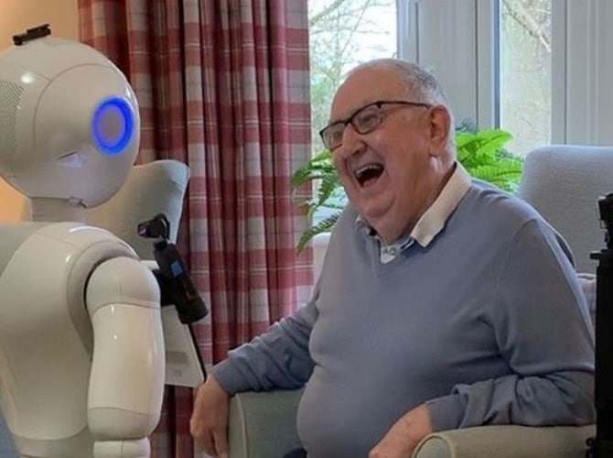
objectives
In our proposed system the user can chat with the bot
regarding the query through voice or text.
User can also view the available doctors for that particular disease.
Bot will provide analgesics and food suggestions that means which food you have to take based on the disease
Reducing health care cost
Save the user time
Don‘t go to hospital for even any small problem

Slide 7
LITERATURE SURVEY
Chatbot Utilization for Medical System. Four stages of Med Bot integration research, which includes system analysis, system design, development, and process testing.
Device Analysis First, DoctorMe was thoroughly studied to find out regarding potential diseases, medications and herbs that could be used to alleviate the symptoms. The 16 signs were reported including nausea, fatigue, vomiting, headache, conjunctivitis, sore throat, feeling dizzy, skin rash, knee pain, diarrhea, dark-colored sweat, dengue, migraine, stuffy, catarrh and stomach ache. In the later step the information is used to train the chatbot. Nonetheless, we have also identified other limitations from this analysis that may impact users while utilizing the software, including 1. Device deployment is needed, 2. Device instruction adaptation is necessary, 3. Application compliance for tablets and smartphones only. 4. Chatbot will remove certain restrictions. Users no need to update to the latest version and learn it. We are going to use the IM system, which we still have and where they are using.

Slide 8
Chatbot Design MedBot is built to serve as a nurse, diagnosis and treatment authority. She'll send patients the recommendation and send them medical advice. The object of the chatbot is merely to provide general symptoms to the consultation. In addition to these, the chatbot will start treating the patients like an actual doctor. MedBot has 34 attempts including 16 discomfort attempts, ten sub-detail stomachache attempts, five sub-detail headache attempts, one chatbot salutation attempt, one no-illness attempt and one attempt to find a doctor by contact. MedBot provides a recommendation about such efforts that the patient treat the doctor for some slight symptoms. The chatbot was trained for these intents.

Slide 9
Development:
The key method used by Google for developing MedBot was the Dialogflow. The moves for this activity are below. 1. Create an Agent (MedBot) in Dialogflow using Google Account. 2. In DoctorMe, prepare the use of health details to generate aim. 3. Sentences and replies to commands are intentional apps.
Testing:
The final step of the development process is the testing. There are 2 evaluation stages, i.e. during the preparation evaluation and the system test. Training is to test the contact expression of a device through testing, and to search for the response. If the response isn't right, more training phrases are required. This approach can be extended to the chatbot in a programming tool. The system checking is conducted upon completion of program implementation. Simulation of the conversion is installed and tested

Slide 10
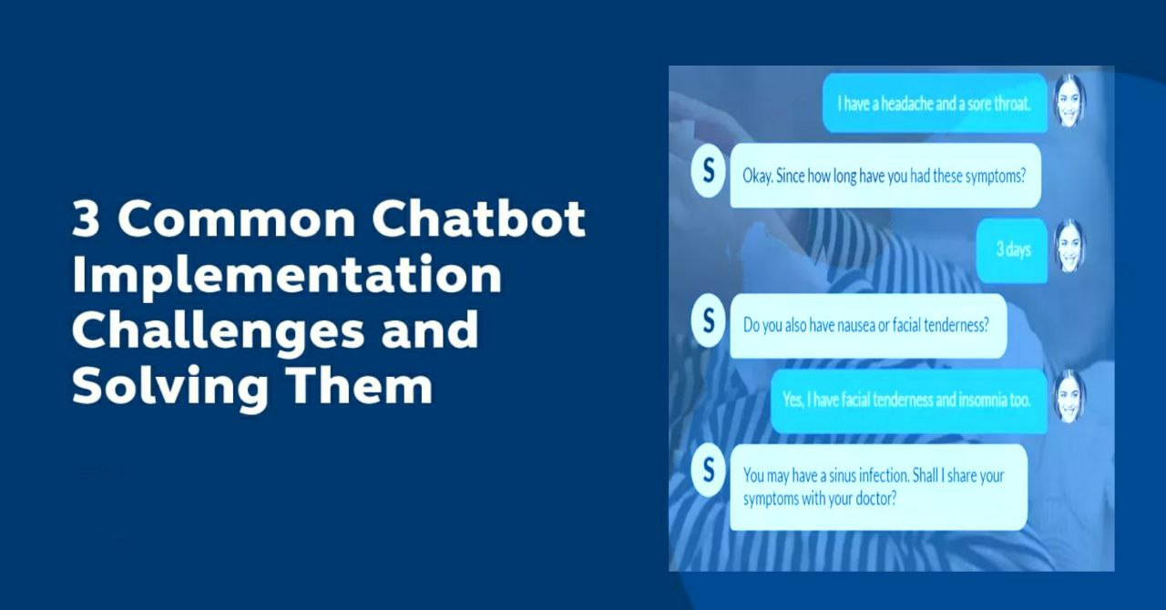
how to implement
Chatbots are programs that work on Machine Learning (ML) as well as Artificial Intelligence (AI)Natural Language Processing
(NLP) techniques such as NLTK packages for Python can be applied to analyses speech, and intelligent responses can be found by designing an engine to provide appropriate human like responses.

Slide 11
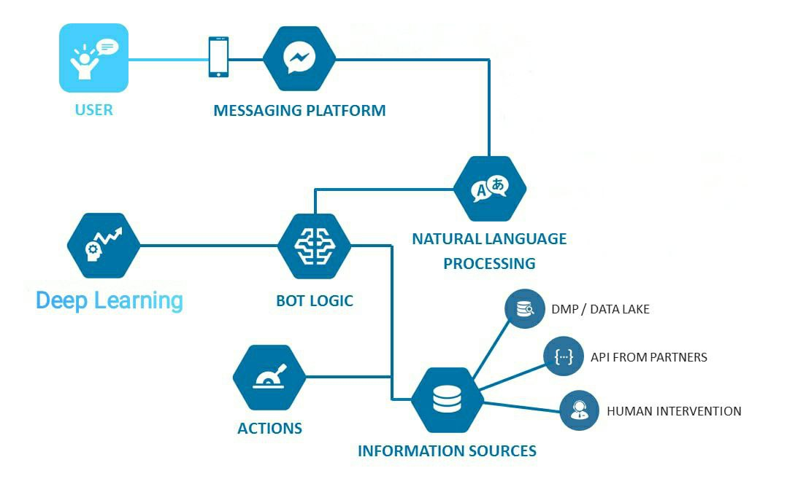
How chatbot works
Steps:
Import corpus(Giving Data)
Preprocess the data
Tokenization
Stemming
TF-IDF
Cosine similarity algorithm

Slide 12
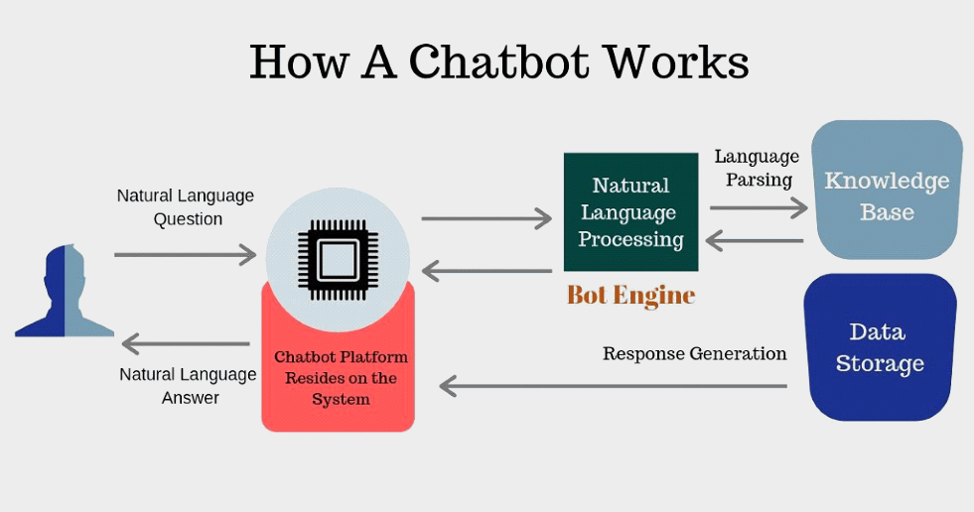
Step1
In this step the user gives the input in the form of chat or audio.
The corpus analyse the word related to user input.
Corpus: It trains data needed for chatbot.
Without these corpus it is not possible for a chatbot to analyse and replies to user symptoms.

Slide 13
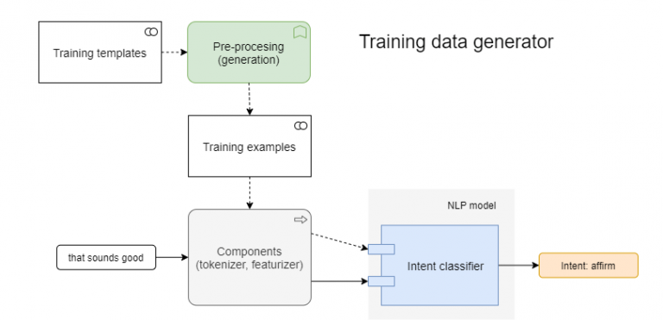
Step2: preprocess the data
Here we convert all data input into uppercase or lowercase and correct the sentences

Slide 14
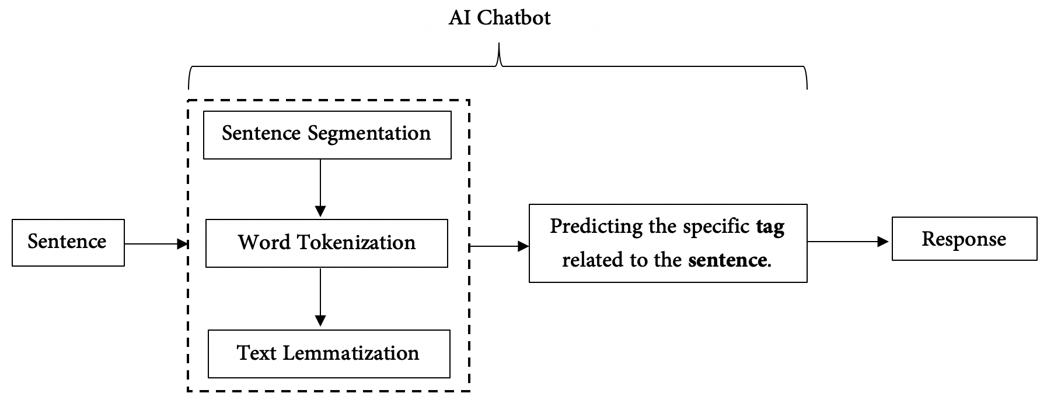
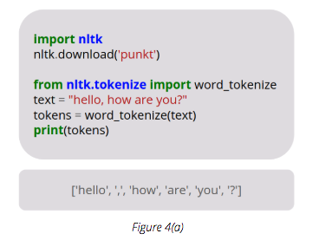
Step3: Tokenization
The NLP divides a string of words into pieces or tokens. These tokens are linguistically symbolic or are differently helpful for the application.

Slide 15
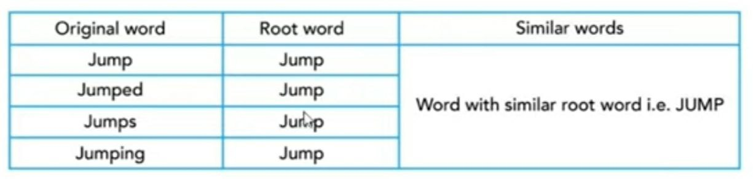
Step4: stemming
Stemming is basically removing the suffix from a word and reduce it to its root word.
For example: “Flying” is a word and its suffix is “ing”, if we remove “ing” from “Flying” then we will get base word or root word which is “Fly”.
We uses these suffix to create a new word from original stem word.

Slide 16
Algorithms
And we use Algorithms like:
TF-IDF(Term frequency-inverse data frequency)
Cosine similarity algorithm

Slide 17
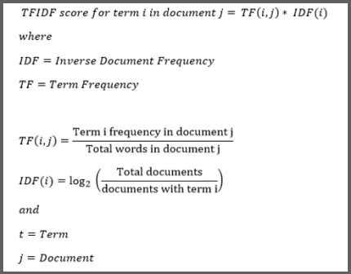
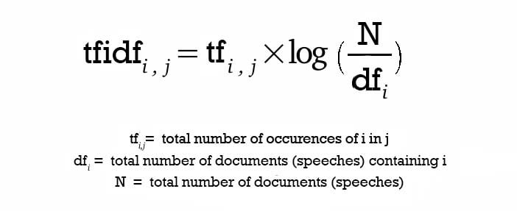
TF-IDF(Term frequency-inverse data frequency)
TF-IDF means Term Frequency-Inverse Document Frequency and it is used to convert the text into vectors in our project. This technique is widely used to extract features across various NLP applications.

Slide 18
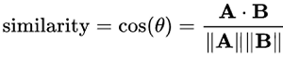
Cosine similarity algorithm
WE Measure similarity between two sentences in our project by using
cosine similarity.
Cosine similarity is a measure of similarity between two non-zero vectors of an inner product space that measures the cosine of the angle between them. Similarity = (A.B) / (||A||.||B||) where A and B are vectors.

Slide 19
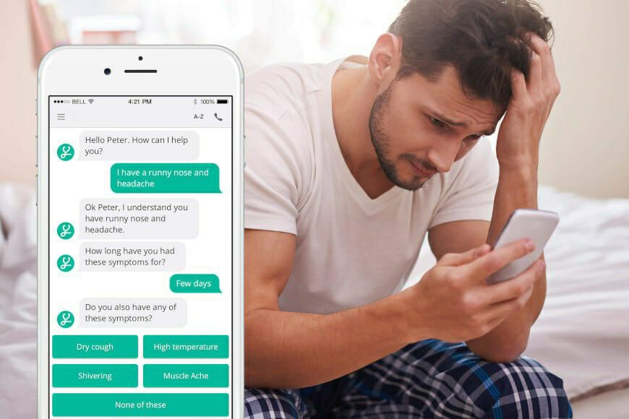
CONCLUSION
chatbots are user-friendly.
It is the application based and the user can use these chatbots very easily. Healthcare chatbot is great tool for conversation language between human and machine. And provides the information related to user symptoms.
These chatbot acts as a medical reference, which helps the patient know more about their disease and helps to improve their health.

Slide 20
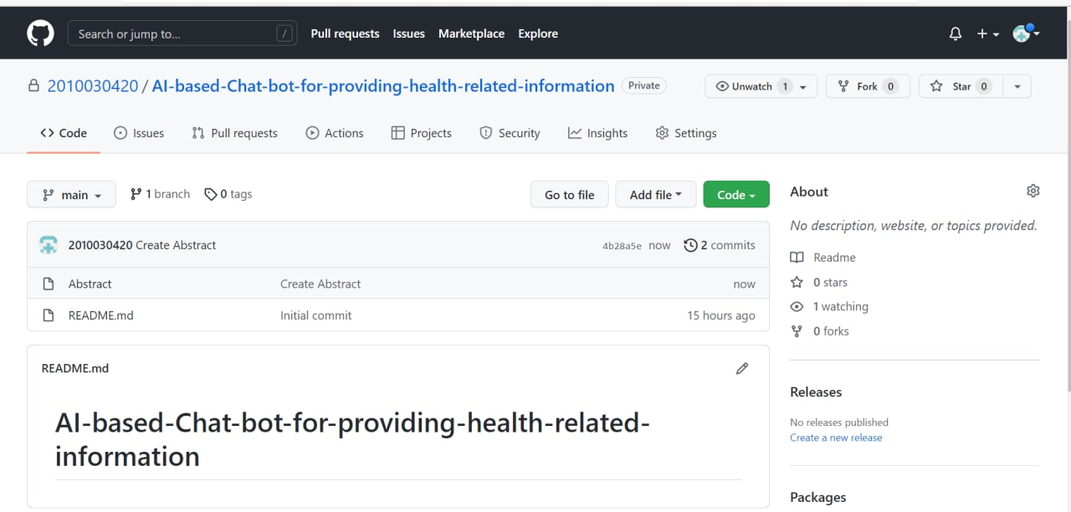
Github setup

Slide 21
THANK YOU

